Slide 1
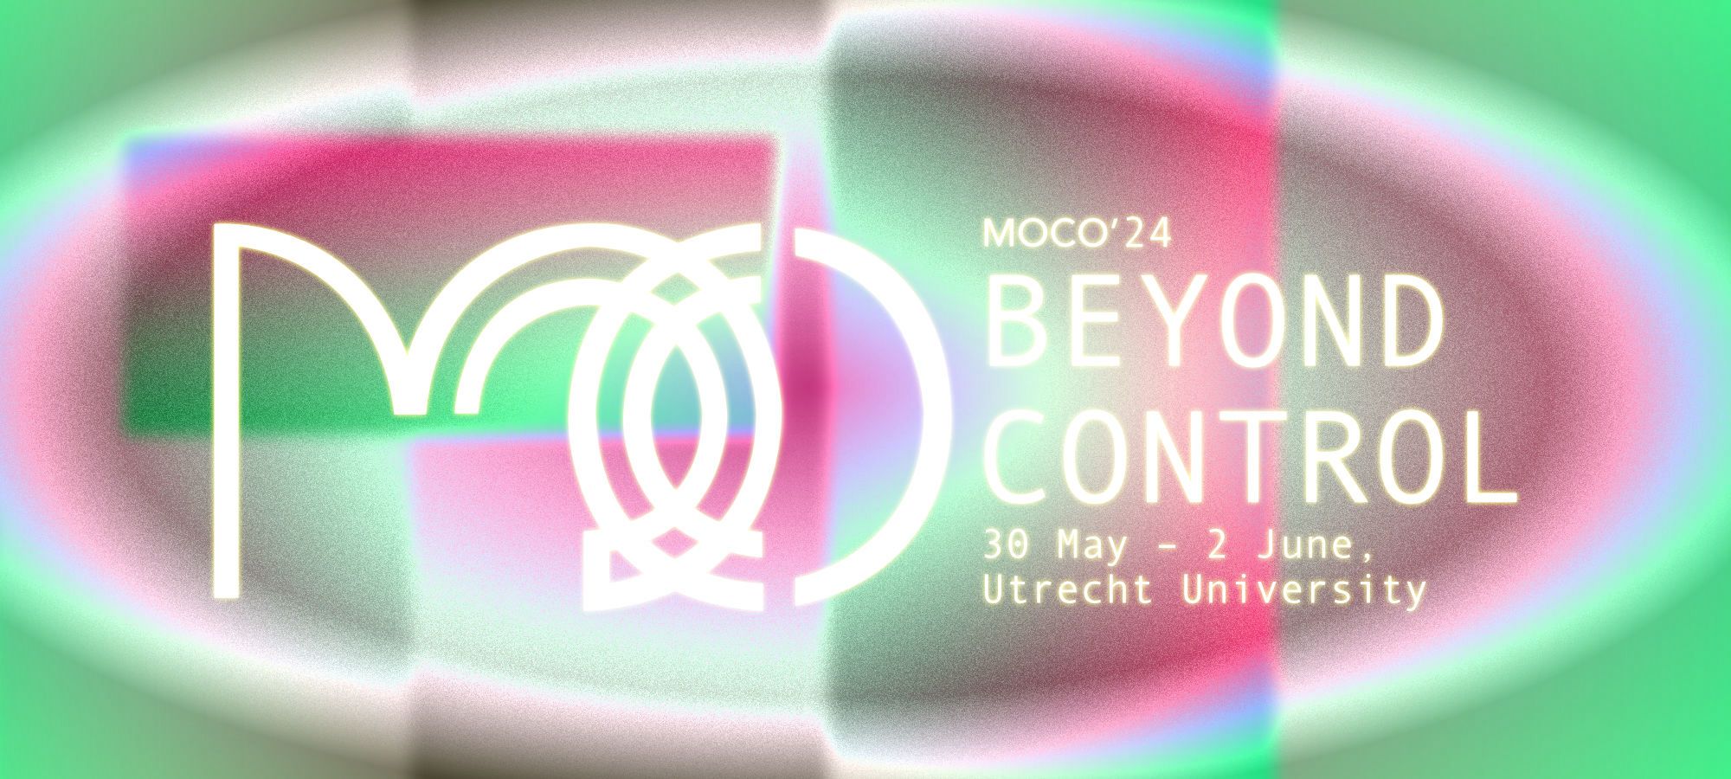




Sign Language Synthesis using Pose Priors
Paritosh Sharma, Michael Filhol
June 1, 2024
Laboratoire Interdisciplinaire des Sciences du Numérique – LISN, CNRS
paritosh.sharma@lisn.upsaclay.fr
michael.filhol@cnrs.fr
1

Slide 2
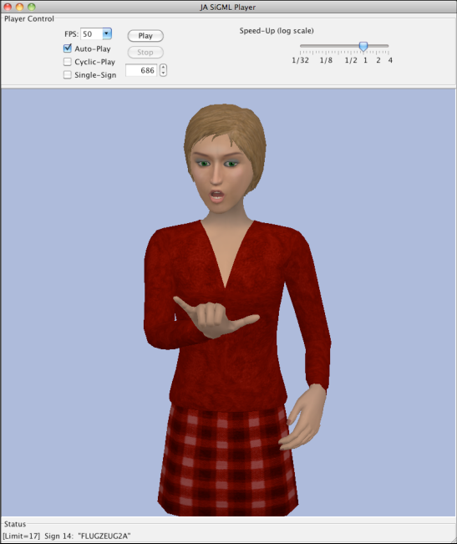
Introduction
Is Sign Language Universal? – No it’s local and can vary from region to region.
Is Sign Language based on the regional written/spoken languages? – Yes and No
SigML (Elliot et al., 2004)
Generation of Sign Language motion on a virtual signer from some data.
Applications in Education, Media, Health Care, Virtual Assistants, etc.
2

Slide 3
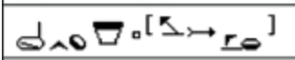


Background: Sign Language Representation
Mostly represented as a sequence of glosses.
Let’s meet tomorrow.
HamNoSys (Hanke, 1980)
meeting
tomorrow
Problems
Assumes signs as a sequence
Relies on the spoken/written language
SignWriting (Sutton, 1974)
Allows us to write parameterized signed forms for semantic functions.
Non-linear and generates a timeline.
(Filhol, 2014)
3

Slide 4
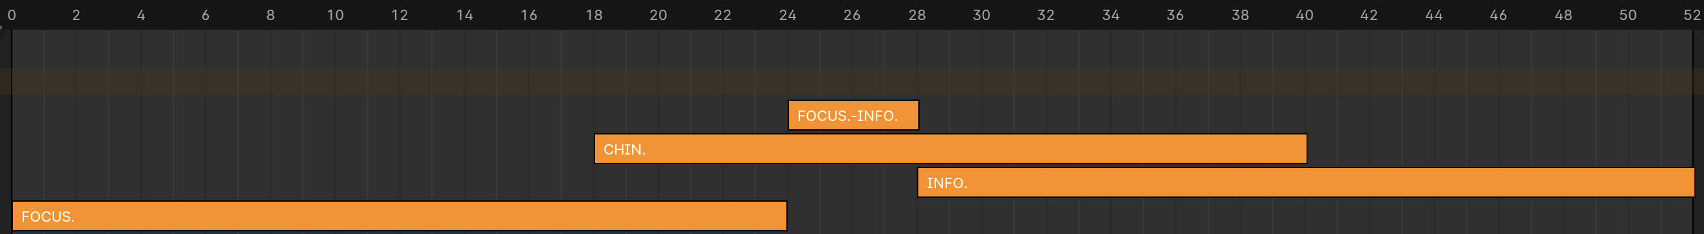
Background: AZee
Let’s meet tomorrow.
FOCUS
:meet
:side-info
'focus
:meet
'info
:tomorrow
INFO
:tomorrow
chin-up
Timeline
4

Slide 5
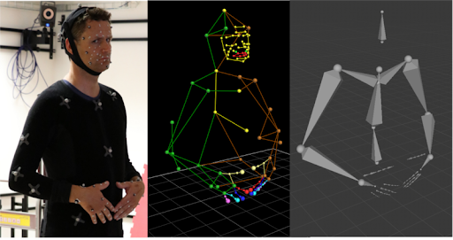
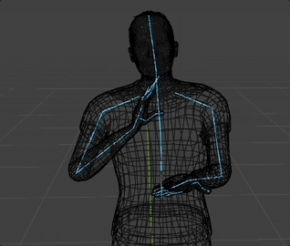
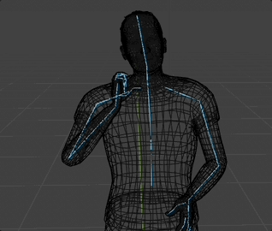
Background: Pre-animated Signs or “shortcuts”
Can be Mocap, Artist defined, etc.
Advantages:
Looks natural.
Disadvantages:
Labor intensive
Difficult to isolate signs and reuse them(for Mocap)
Difficult to isolate identity of the signer
Problems with Re-targeting
Mocap
Let’s meet tomorrow.
FOCUS
:meet
:side-info
'focus
:meet
'info
:tomorrow
INFO
:tomorrow
chin-up
5

Slide 6
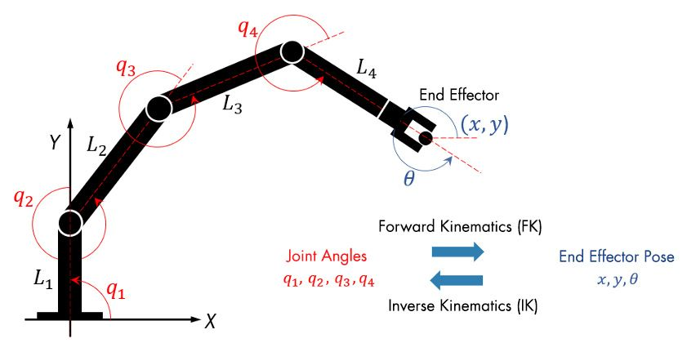
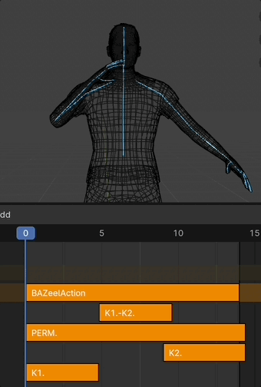
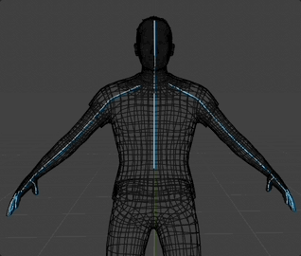
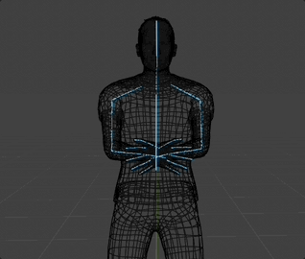
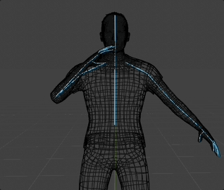
Background: Synthesis by Constraint Optimization(Low-level / Bottom-Up)
Advantages:
A linguist can create signs
Easy to reuse
Fully robotic motion, i.e. no identity.
Disadvantages:
Doesn’t look natural since it’s robotic.
IK vs FK
:meet
K1
PERM
K2
Place right hand on chin
Extend all 4 fingers
Orient …
Place left hand on loc
Place right hand on left hand
Meet(Low-level S.)
6

Slide 7
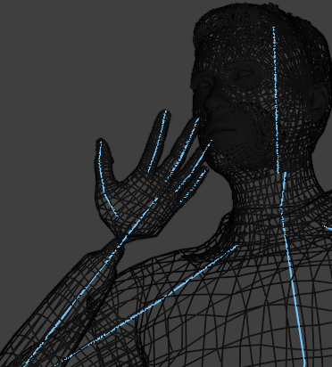
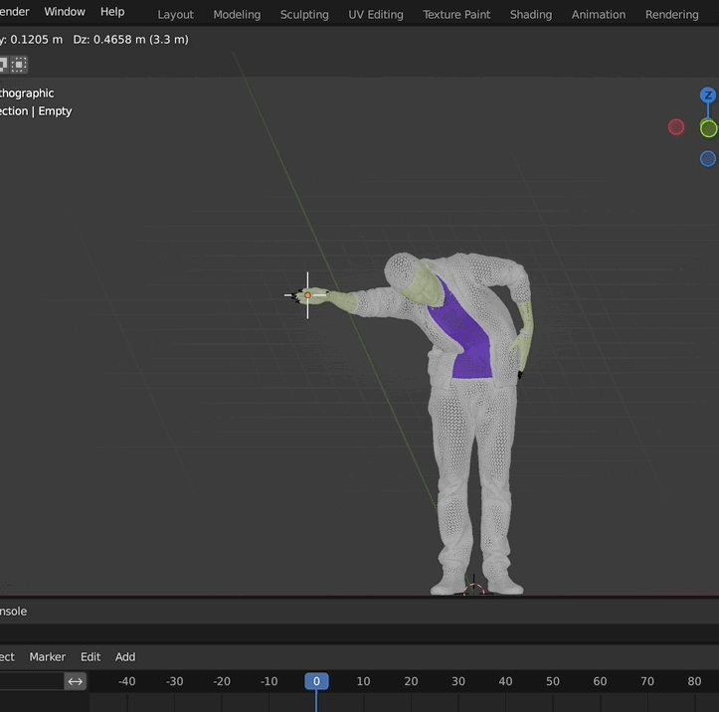
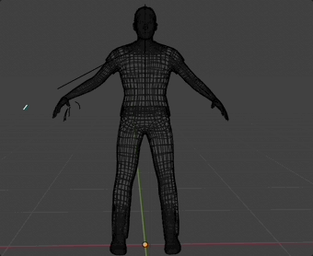
Problem
Procedural generation can sometimes lead to broken postures.
We can use joint limits but the joint posture of the human body is not arbitrary and must obey a certain distribution.
We can’t expect the linguist to always specify every tiny detail of the pose.
Broken Joint on Hand
Marionette effect for long IK chains
IK restricted to arms
7

Slide 8

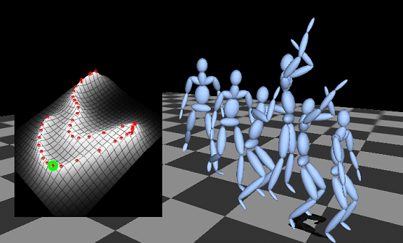
Background: Motion/Pose Matching
Popularized by Ubisoft in 2016.
Matching the pose based on input parameters. Thus, a more granular level for “shortcutting”
Ubisoft For Honor
Various ways to do it:
Style IK (Growchow et al., 2004) used SGPLVM to create a latent space of poses.
Phase-Functioned Neural Networks for Character Control (Holden et al., 2017)
Style IK
8

Slide 9
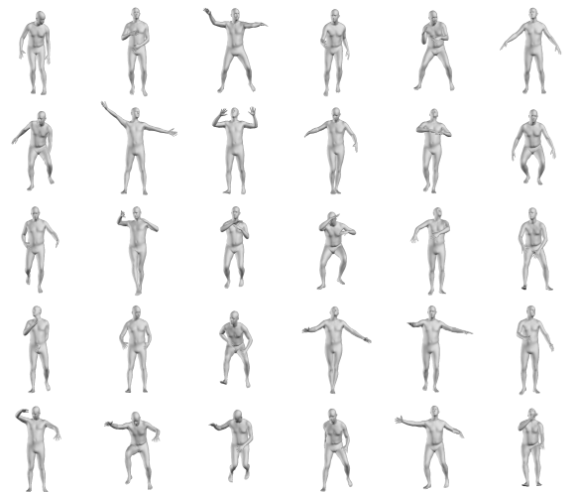
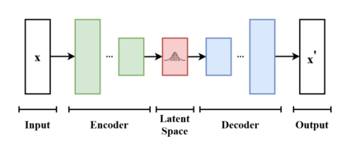
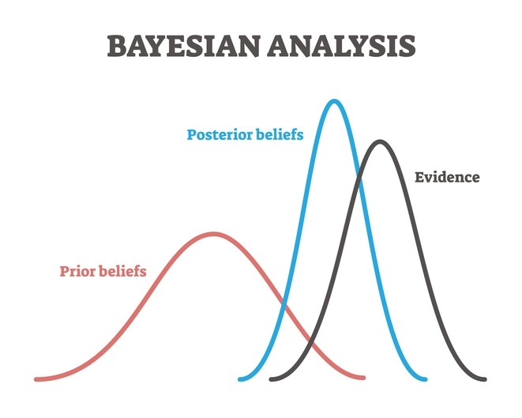
Background: Pose priors
A pose prior is a statistical model that penalizes anatomically impossible poses.
VPoser (Pavlakos et al., 2019) used a variational autoencoder (Kingma et al., 2014) to learn a latent representation of the human pose.
VPoser in SMPLX
VAE
Bayesian Analysis
9

Slide 10
Step 1: Constraining the Avatar using AZee
Constraints from Parallel Blocks: Aggregates constraints from parallel blocks for each frame.
Solves for current block while accounting for parallel constraints
Passes to pose corrector for motion matching
10
11/22

Slide 11
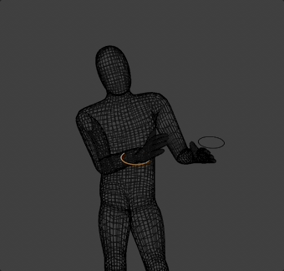
Step 2: Pose Correction based on VPoser
[…]
[…]
VPoser
AZee resolved Body Pose
Body Pose after Motion Matching
Matches the AZee resolved pose based on a prior.
Average key pose matching takes around 1 second for 100 iterations, and lr=3e-1.
Correction for IK
11
11/22

Slide 12
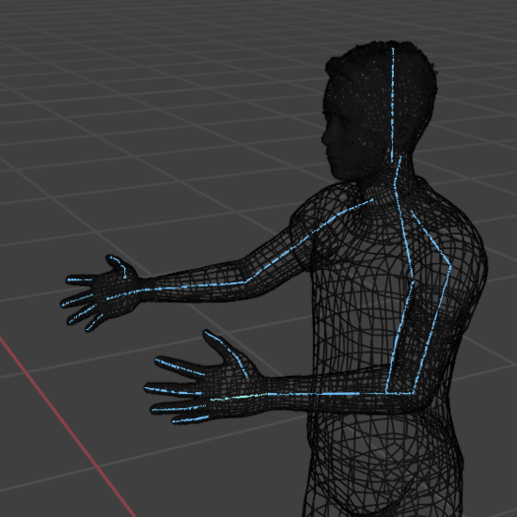
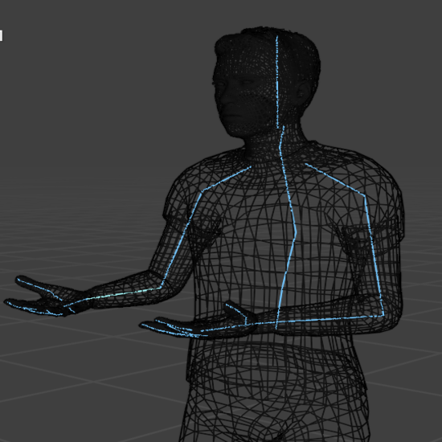
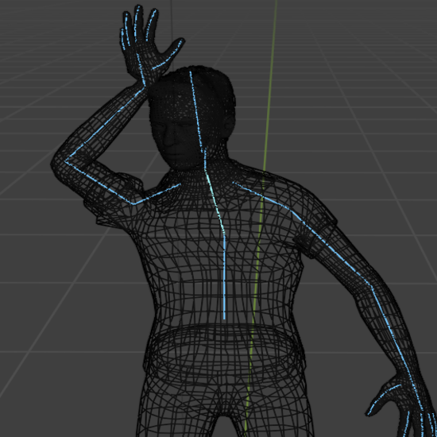
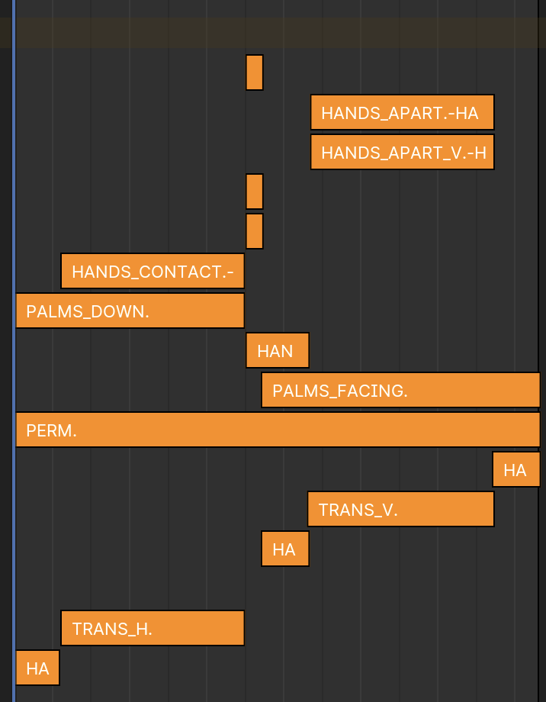
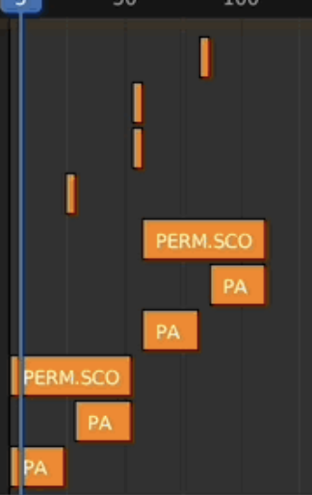
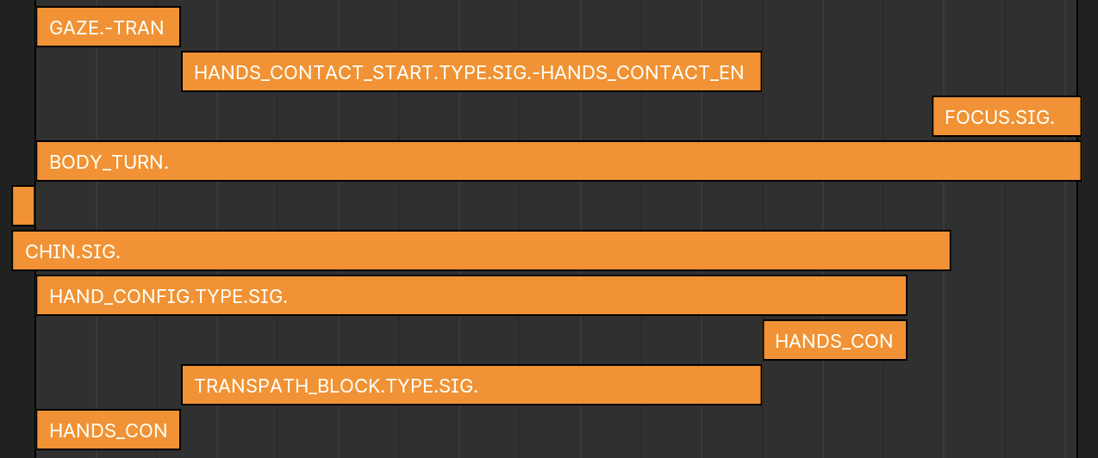
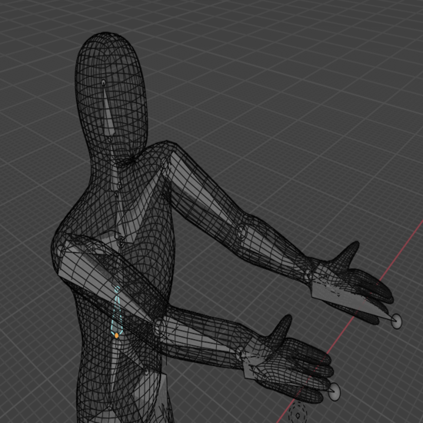
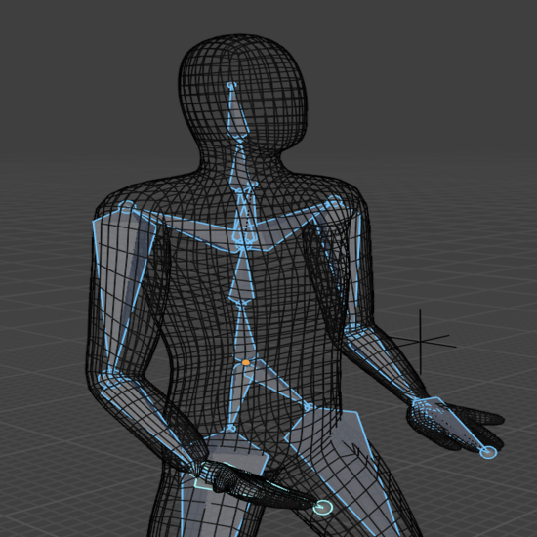
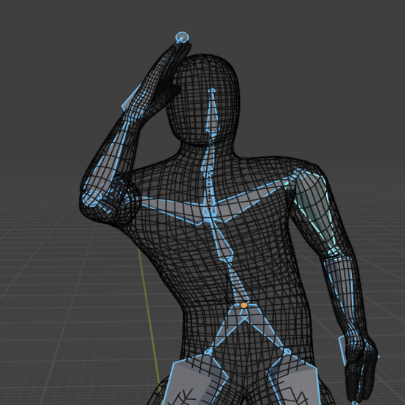
Results and Discussion
Without VPoser
:about-ref
pt
^Rssp
'info
:instance-of
'type
:pays
‘elt
:Irak
AZee
:cupboard
:now
With VPoser
12
11/22

Slide 13
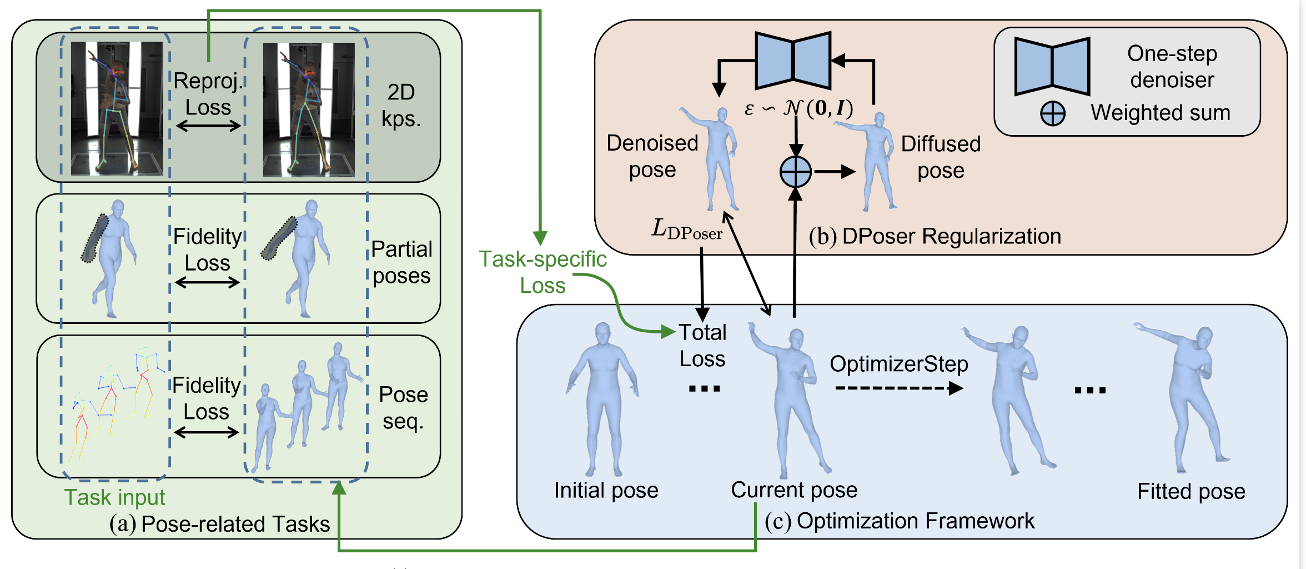
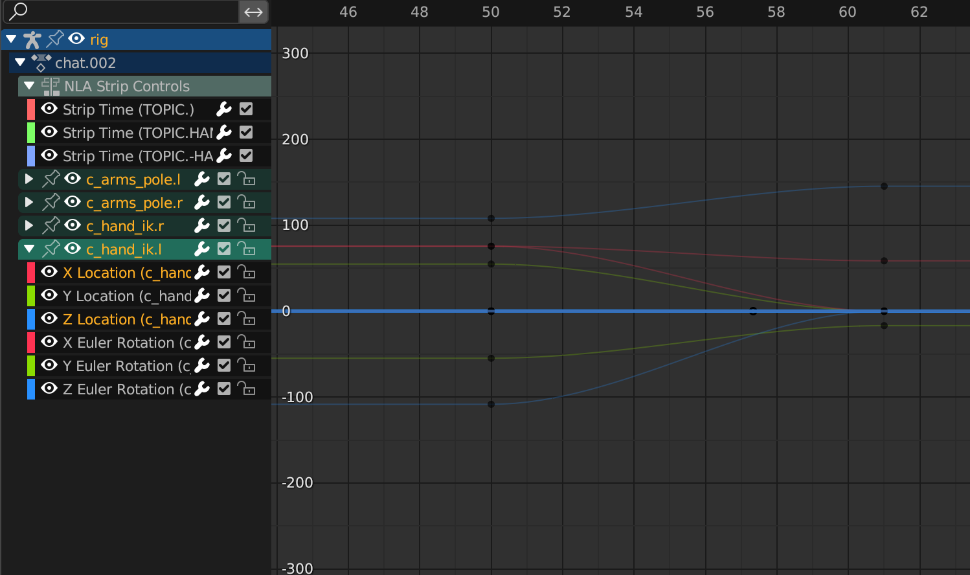
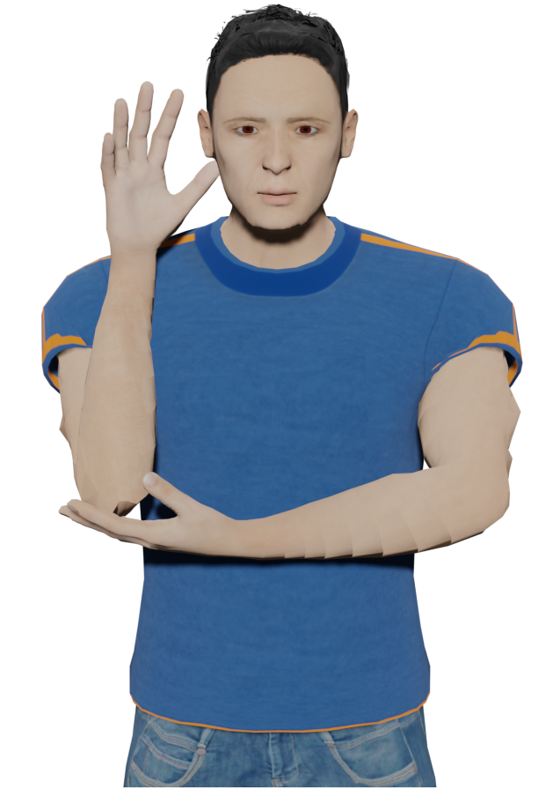
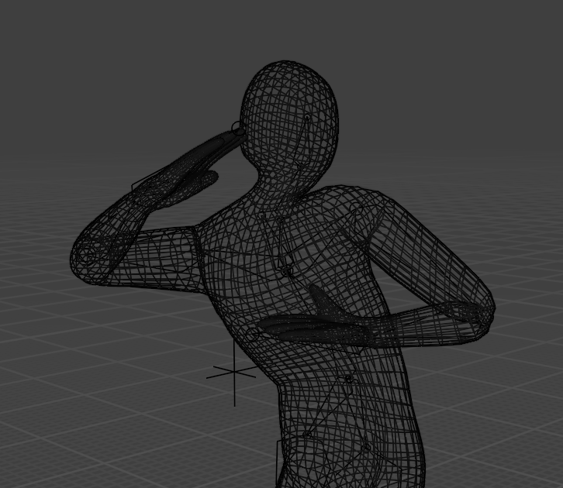
Future Work
Fingers
Bayesian assumption
Matching motion curves
Test on longer discourses and evaluation
DPoser (Lu et al., 2022)
Motion Curves
Good Tree
Overfitting due to Bayesian assumption
13
11/22

Slide 14
Thank you
1

